Slide 1
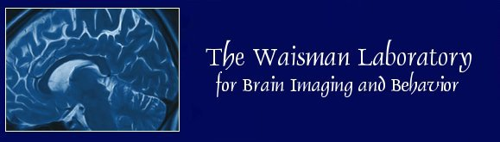

BMI/STAT-768
Statistical Methods for
Medical Image Analysis
Moo K. Chung
Department of Biostatistics and Medical Informatics
Waisman Laboratory for Brain Imaging and Behavior
University of Wisconsin-Madison
www.stat.wisc.edu/~mchung

Slide 2
Introduction to MATLAB programming

Slide 3
Unit Objectives 1. Get familiar with Matlab 2. 5 components of programming 3. Combining 5 components in solving complex examples.

Slide 4
MATLAB
MATLAB (matrix laboratory) is a numerical computing environment and fourth-generation programming language.
A proprietary programming language developed by MathWorks.
MATLAB allows matrix manipulations, plotting of functions and data, implementation of algorithms, creation of user interfaces, and interfacing with programs written in other languages, including C, C++, Java, Fortran and Python.

Slide 5
MATLAB
Dr. Cleve Moler, the chairman of the computer science department at the University of New Mexico, developed MATLAB in the late 1970s to give his students access to LINPACK without them having to learn Fortran.
LINPACK: linear algebra package written in C/Fortran. It is now widely used amongst scientists involved in image processing and medical imaging.
MATLAB use LINPACK for linear algebra computation
Mainly used in numerical analysis, scientific computation, image computation

Slide 6
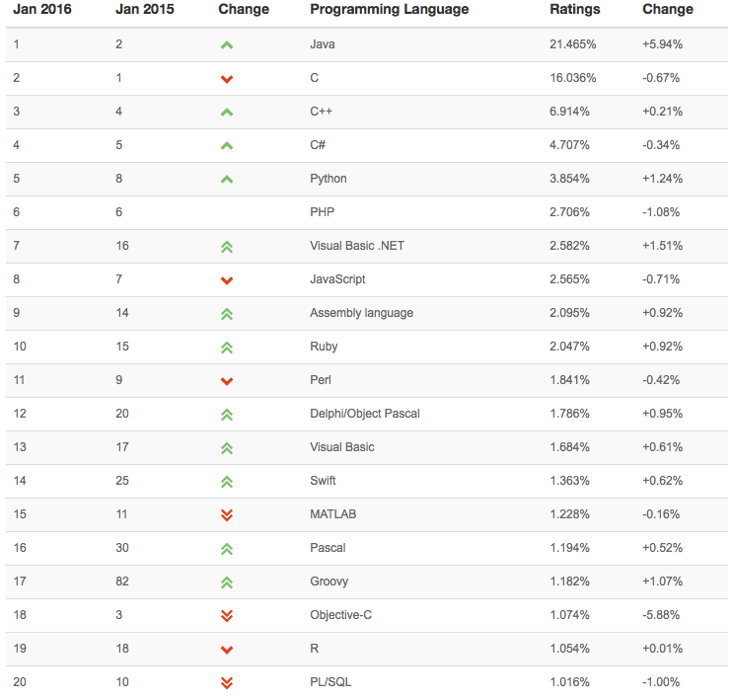
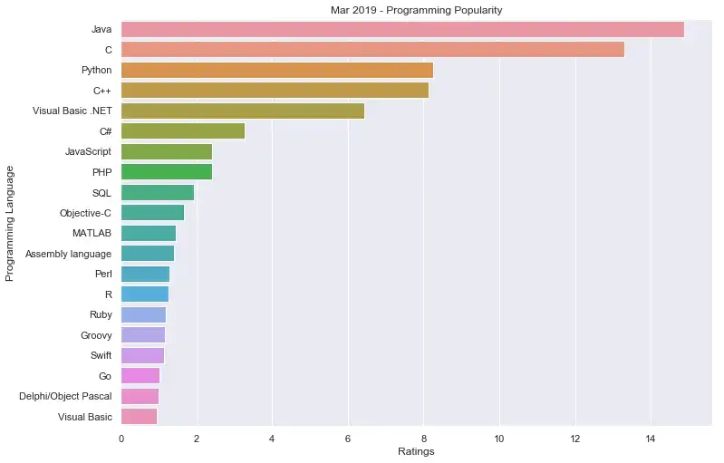
Ranking of programming languages for data science

Slide 7

Interfacing with other languages
MATLAB can call functions and subroutines written in the C, Fortran, Python, Perl, Java, ActiveX.
A wrapper function is created allowing MATLAB data types to be passed and returned.
The dynamically loadable object files created by compiling such functions are termed "MEX-files”
MEX: MATLAB executable

Slide 8
Syntax
Mostly C-like scripting language.
Variables are defined using the assignment operator, =. MATLAB is an inferred typed language because variables can be assigned without declaring their type.
Variable type can be easily changed.
Very forgiving to syntax errors. Multiple ways to write a function → Fast prototyping language.
Baseline tool for image processing and image analysis.

Slide 9
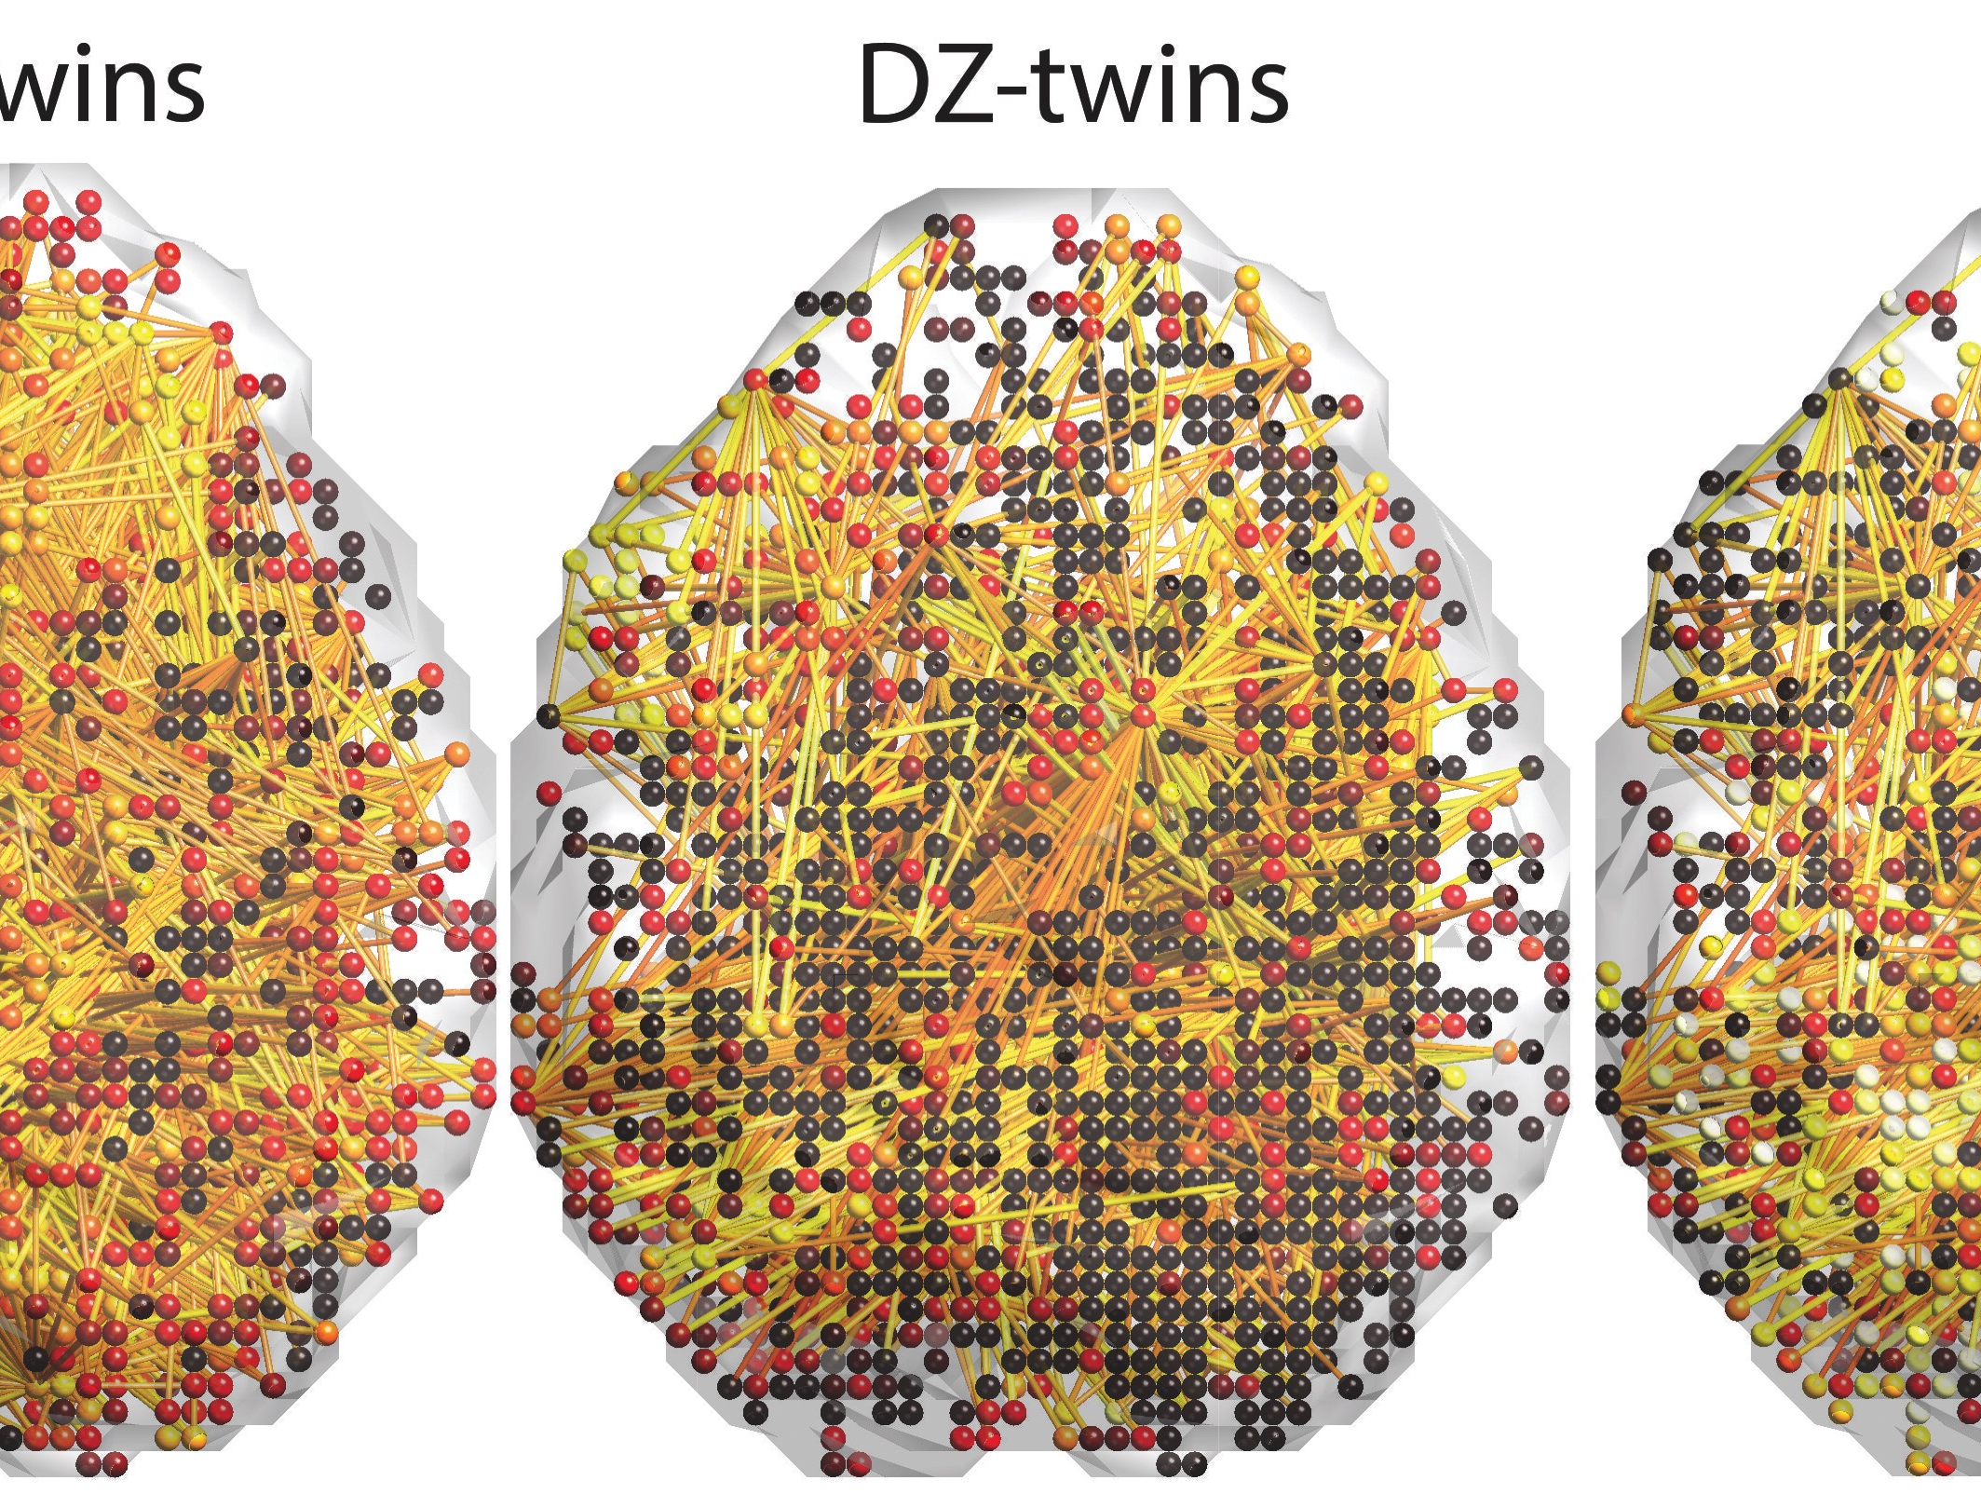

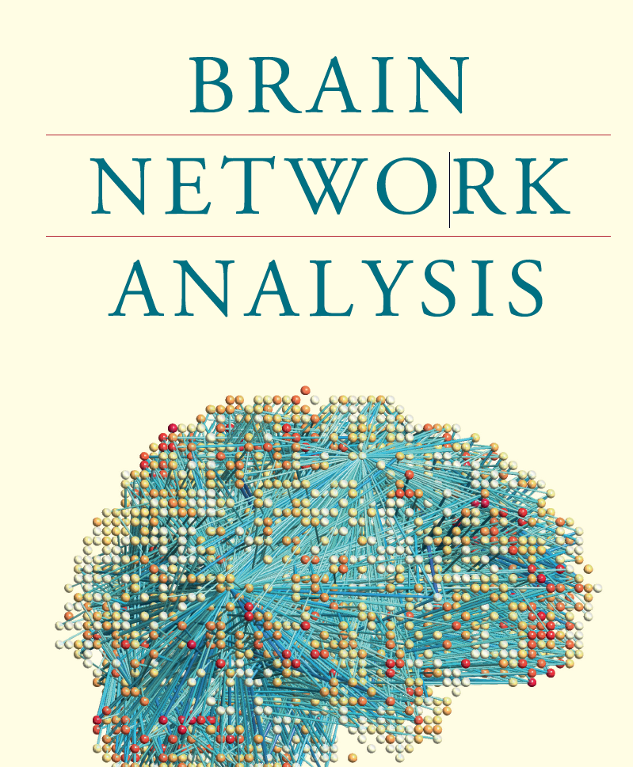
Chung et al. 2015 arxiv.org/abs/1509.04771
Medical Image Visualization in MATLAB

Slide 10
Advanced programming only needs 5 things
Almost all algorithms can be written using 1) variables, 2) functions, 3) iterations, 4) conditional statements and 5) random numbers.
Examples
Optimization: Iterations on functions
Matrix inversion: Iterations on matrix variables
Partial differential equation: Iterations on a system of linear equations.
Question: Can you come up with an algorithm that uses more than these five?

Slide 11
Variables
>> x = 17
x =
17
>> x = 'hat'
x =
hat
>> x = [3*4, pi/2]
x =
12.0000 1.5708
>> y = 3*sin(x)
y =
-1.6097 3.0000
Variable assignment is intuitive and easiest.
Biggest source of programming error.

Slide 12
Iterations
Iteration is the act of repeating a process with the aim of approaching a desired result.
Each repetition of the process is also called an "iteration", and the results of one iteration are used as the starting point for the next iteration.
Recursion is the process of repeating items in a self-similar way in a nested fashion. Recursion is a special case of iteration.

Slide 13
Programming suggestions
Avoid recursion in MATLAB if possible. Difficult to read and debug codes.
Avoid using “break” if possible.
break Terminate execution of WHILE or FOR loop. break terminates the execution of FOR and WHILE loops. In nested loops, break exits from the innermost loop only. Difficult to read.

Slide 14

Iterations
Iterate forward
total=0
for i=1:100
total = total +i
end
Iterate backward
total=0
for i=100:-1:1
total = total +i
end
Example 1.
total=0
for i=100:2:1
total = total +i
end
Example 2.
total=0
for i=100:-2:1
total = total +i
end

Slide 15
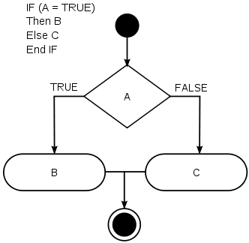
Conditional statements
Conditional statements are features of a programming language, which perform different computations or actions depending on whether a programmer-specified boolean condition evaluates to true or false.

Slide 16
Conditional statements
>> 3>2
ans =
1
>> 3<2
ans =
0

Slide 17
Example. Finding maximum of a 1D function
x=-50:50
y=cos(x)./(x.^2+1)
n=length(x)
ind=1;
temp=y(ind)
for i=2:n
if y(i)>temp
ind=i;
temp=y(i);
end
end

Slide 18
Functions
MATLAB supports lambda calculus by introducing function handles or function references, which are implemented in .m files.
When creating a MATLAB function, the name of the file should match the name of the function in the file.
Lambda calculus: (λ-calculus) is a formal system in mathematical logic for expressing computation based on function abstraction and application using variable binding and substitution. First introduced by mathematician Alonzo Church in the 1930s. Lambda calculus is a universal model of computation equivalent to a Turing machine.

Slide 19
Functions
Syntax
output = name(input)
First line of file name.m
function output = name(input)

Slide 20
function [xmax, mymax] = max2(x,y);
n=length(x)
ind=1;
temp=y(ind);
for i=2:n
if y(i)>temp
ind=i;
temp=y(i);
end
end
xmax=x(ind);
mymax=temp;

Slide 21
Random number generators
A random number generator (RNG) is a computational or physical device designed to generate a sequence of numbers or symbols that can not be reasonably predicted better than by a random chance.
Almost all computational algorithms that can produce long sequences of apparently random results, which are in fact completely determined by a seed value.
The entire seemingly random sequence can be reproduced if the seed value is known. This type of random number generator is often called a pseudorandom number generator.

Slide 22
Random number generators
Discrete uniform random numbers
n=10
x=unidrnd(n, [1 10])
x =
4 2 3 7 5 4 9 6 6 10
Quiz 1. Can you generate continous random numbers between [0 1] using unidrnd?

Slide 23
Random number generators
Poorman’s continous uniform distribution
n=10000
x=unidrnd(n, [1 10])
x=x/n
x =
0.6020 0.2630 0.6541 0.6893 0.7482 0.4506 0.0839 0.2290 0.9134 0.1524
Quiz 2. Is there a number in [0,1] you can‘t generate with the above procedure?

Slide 24
Histogram: probability distribution
A histogram is a graphical tool for understanding the distribution of numbers. It is an estimate of the probability distribution of the data and was first introduced by Karl Pearson.
To construct a histogram, the first step is to "bin" the range of values—that is, divide the entire range of values into a series of intervals—and then count how many values fall into each interval.
Quiz 3. Write MATLAB codes for displaying the histogram of given data without using the built-in function hist.

Slide 25
Random number generators
x=unifrnd(0,1, [1 10])
x =
0.8258 0.5383 0.9961 0.0782 0.4427 0.1067 0.9619 0.0046 0.7749 0.8173
x=unifrnd(0,1, [1 n]);
figure; hist(x,100)
n=1000
n=100000

Slide 26
Random number generators
Quiz 3. Generate random numbers with bell-shaped histogram using the uniform random numbers.
Fisher‘s z-transform:
Inverse hyperbolic arctan
x
z

Slide 27
Advanced Example 1 Sampling + random numbers + plotting

Slide 28
Data visualization
Plotting scatter points
x=unifrnd(-1,1,[1, 100])
y=unifrnd(-1,1,[1,100])
figure; plot(x,y,'+k')

Slide 29
Data visualization
Plotting explicit curves
x=unifrnd(0,1,[1, 10])
x=sort(x);
y=x.^2;
figure; plot(x,y,'+k')
hold on; plot(x,y,'r’)

Slide 30
Uniform sampling
Plotting explicit curves: a circle with radius 1
x=unifrnd(-1,1,[1, 100])
y=sqrt(1-x.^2)
figure; plot(x,y,'+k')
hold on; plot(x,-y,'+k’)
Quiz. Can you draw points
uniformly sampled points
on a circle?

Slide 31
Uniform sampling
Plotting explicit curves: a circle with radius 1
x=-1:0.05:1
y=sqrt(1-x.^2);
figure; plot(x,y,'+k')
hold on; plot(x,-y,'+k')
Quiz 2. Still not uniform enough. Why?

Slide 32
Uniform sampling
Plotting implicit curves: a circle with radius 1
theta=0:0.05:2*pi
x=cos(theta)
y=sin(theta)
figure; plot(x,y,'+k')
Uniform sampling has to be done with respect to the manifold (parameter space) Bertrand Russel’s paradox (1889)

Slide 33
Advanced Example 2 Convergence + Speeding up computation

Slide 34
Computation of Pi
pi=3.141592….
Using iterations and uniform random number generator, we can compute the digits of pi as accurately as possible.
How?
Suggestion: Monte-Carlo simulation
(rejection sampling)

Slide 35
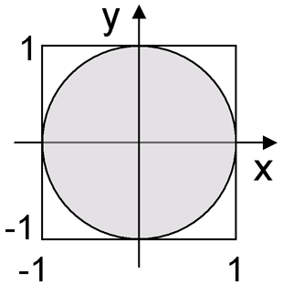
Computation of Pi
Math fact: area of the circle = Pi
Goal: estimate the area of the circle
Algorithm:
Uniformly sample n points (x,y) from [0, 1]^{2.}
2) Count the number of points within the circle. Call it p.
3) Area of circle = 4* p/n = Pi.

Slide 36
OurPi=[];
for n=1:10000
n
x=unifrnd(0,1,[1, n]);
y=unifrnd(0,1,[1, n]);
r=sqrt(x.^2 + y.^2);
p=length(find(r<=1));
OurPi = [OurPi 4*p/n];
end
figure; plot(OurPi)
We don’t need sqrt here. r^2 <=1 is equivalent to r<=1

Slide 37
Convergence rate of the Monte-Carlo simulation
Ground truth
3.141592….
Quiz. This dose not seem to converge. What’s wrong?
Can you speed up the convergence?

Slide 38
figure; axis square;
n=100
x=unifrnd(0,1,[1, n]);
y=unifrnd(0,1,[1, n]);
r=sqrt(x.^2 + y.^2);
figure; plot(x,y,'+k')
p=0
for i=1:n
if r(i)<=1
p=p+1;
hold on; plot(x(i),y(i),'or')
end
end
ourPi = 4*p/n
>> ourPi
ourPi =
3.4000

Slide 39
More efficient code
OurPi=[];
x=unifrnd(0,1,[1, 10000]);
y=unifrnd(0,1,[1, 10000]);
r=x.^2 + y.^2;
for n=100:100:10000
temp=r(1:n);
p=length(find(temp<=1));
OurPi = [OurPi 4*p/n];
end
figure; plot(OurPi)
Random numbers are generated once outside of the loop.
If possible, do NOT use loop in MATLAB
programming.

Slide 40
Advanced Example 3 Matrix computation + least squares estimation

Slide 41
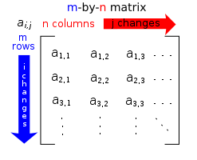
A matrix is a rectangular array of numbers, symbols, or expressions, arranged in rows and columns.
m by n matrix
m=3; n=2;
A = zeros(m,n)
A =
0 0
0 0
0 0
Quiz. What will happen if you run A(5,5)=1?

Slide 42
Matrix algebra
A+B >>A+B
AB >>A*B
A2 >>A^2 or A*A
Hadamard product
Frobenius norm
A.*B
Quiz. Write 1-line MATLAB code for computing Frobenius norm.

Slide 43
Kronecker product
Can be used to tile matrices with repeating patterns
>>kron(A,B)

Slide 44
Kroneker matrix product
B=unifrnd(0,1,[5 5])
figure
imagesc(B)
colorbar
colormap('hot')
A=ones(5,5);
C=kron(A,B);
figure
imagesc(C)
colorbar
colormap('hot')
Quiz: Can we extend this concept to tensor product?

Slide 45
Matrix A is called invertible (nonsingular) if there exists an n-by-n square matrix B such that
AB = BA = I_{n} = eye (n).
>>B= inv(A)
assuming det(A) is not zero. Matrix inversion is done
using Gaussian elimination: O(n³). The lowest bound:
O(n²log n).
Quiz. How to invert really large matrices? You cannot!

Slide 46
Matrix equation
Determined system
x+z = 4
-x+y+z = 4
x -y + z = 2
A=[1 0 1
-1 1 1
1 -1 1]
b=[4 4 2]'
X=A\b
X =
1
2
3
X=inv(A)*b
Backslash \ uses Gaussian elimination
AX = b
X= A⁻¹b

Slide 47
Matrix equation
Over-determined system
x = 4
-x+y = 4
x –y = 2
Quiz. Mathematically there is no solution. So how to solve this problem?

Slide 48
Least squares estimation (LSE)
We will approximately solve
AX = b
by minimizing ||AX-b||².
The least squares method grew out of the fields of astronomy as mathematicians sought to provide solutions to the challenges of navigating the Earth's oceans during the Age of Exploration.
Even if there is no solution in Ax=b, there is an optimization solution.

Slide 49
f(X) = (x-4)² + (-x+y-4)² + (x-y-2)²=(x-4)²+(x-y-)²
df/dx = 6x -4y - 4 = 0
df/dy = -4x +4y - 4 =0
A=[6 -4
-4 4]
b=[4 4]'
X=A\b
X =
4.0000
5.0000

Slide 50
Least squares method
How to minimize ||AX-b||² ?
Let
Minimum is obtained when the matrix derivative is zero:
The solution is given by X = (A^{T}A)⁻¹A^{T} b assuming A^{T}A is invertible. What if A^{T}A is not invertible?
Quiz Find minimum for general 2x2 matrix.

Slide 51
Moore-Penrose (peudo) inverse
A pseudoinverse A⁻ of a matrix A is a generalization of the inverse matrix. The most widely known type of matrix pseudoinverse is the Moore–Penrose pseudoinverse, which was independently described by E. H. Moore in 1920, Arne Bjerhammar in 1951 and Roger Penrose in 1955.
If A^{T}A is invertible, A⁻ = (A^{T}A)⁻¹A^{T}.
In general, A⁻ is defined as a matrix satisfying
AA⁻A = A, A⁻AA⁻ = A⁻
AA⁻ and AA⁻ are symmetric.
>>pinv(A)

Slide 52
Matrix equation
A=[1 0 0
-1 1 0
1 -1 0]
b=[4 4 2]'
pinv(A)
ans =
1.0000 -0.5000 -0.5000
1.0000 -0.0000 -1.0000
0.0000 0.5000 0.5000
X=pinv(A)*b
X =
4.0000
5.0000
0
Over-determined system
x = 4
-x+y = 4
x –y = 2
Quiz. Check if the MATLAB solution is the least squares estimation of the above system.
f(X) = (x-4)² + (-x+y-4)²
+ (x-y-2)²

Slide 53
Matrix equation
Under-determined system
-x+y = 4
Mathematically there are infinitely many solutions.
So how to solve this problem?
Can we still use LSE? Yes.
f(X)= (-x+y-4)²
df/dx = 2x-2y+8 = 0
df/dy = -2x+2y -8 = 0
A=[2 -2
-2 2]
b=[-8 8]'
X=pinv(A)*b
X =
-2.0000
2.0000
Question: But why we only get one solution?

Slide 54
Matrix equation
Under-determined system
-x+y = 4
Psudoinverse approach also works.
A=[-1 1
0 0]
b=[4 0]'
X=pinv(A)*b
X =
-2.0000
2.0000
A=[-1 1
-1 1]
b=[4 4]'
X=pinv(A)*b
X =
-2.0000
2.0000
A=[-1 1
1 -1]
b=[4 -4]'
X=pinv(A)*b
X =
-2.0000
2.0000

Slide 55
Unit Outcome MATLAB programming requires breaking abstract concept into an algorithm consisting of 1) variables, 2) functions, 3) iterations, 4) conditional statements 5) random numbers.

Slide 56
Self-assessment Questions 1) Uniformly sample points on a unit sphere. Then display them using plot3.m 2) By uniformly sampling points on the unit sphere, estimate Pi. Is your algorithm slower/faster than algorithm using a circle. Why? 3) Solve the following equations using LSE: x² = 4 -x+y = 4 x –y = 2

